Slide 1
AUDIO SOURCE SEPARATION
SAARANSH AGGARWAL
VIDEETA SHARMA

Slide 2
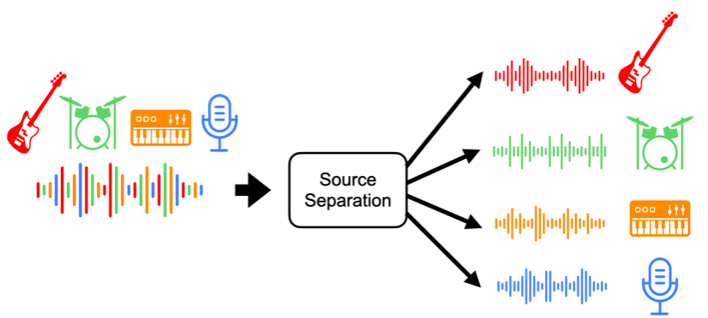
PROBLEM : AUDIO SOURCE SEPARATION
The problem at hand is a simplified version of
music source separation, where we have to
separate voice from the other accompaniments present in the audio.
We have used Stacked Hourglass Networks as proposed in the paper: MUSIC SOURCE SEPARATION USING STACKED HOURGLASS NETWORKS, which appeared in the 19th International Society for Music Information Retrieval Conference, Paris, France, 2018
USES:
INSTRUMENT IDENTIFICATION
LYRICS RECOGNITION

Slide 3
Dataset and Preprocessing
The dataset used is MIR-1K
MIR-1K contains 1000 clips of duration 4 to 13 seconds each
The audio contains 2 channels, the accompaniments are in the left channel and singing voices are in the right channel.
We calculated the STFT to find the magnitude spectrogram, which is the input to the network.
We resampled the audio at 8000 Hz to increase duration of a spectrogram.
The dataset will be split into 3 sets of sizes 60%, 20% and 20% for training, validation and test.

Slide 4
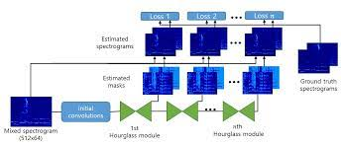
Architecture
The input spectrogram is given as input to 2D convolution and ReLU Activation layers. The output from these is fed into the First Hourglass Module.
Initial convolutional layers consist of a 7*7 convolutional layer and four 3*3 convolutional layers where the number of output feature maps for each layer is 64, 128, 128, 128, and 256 respectively.
A stack of 4 hourglass modules has been used, the structure of each of which has been shown on the next slide.

Slide 5
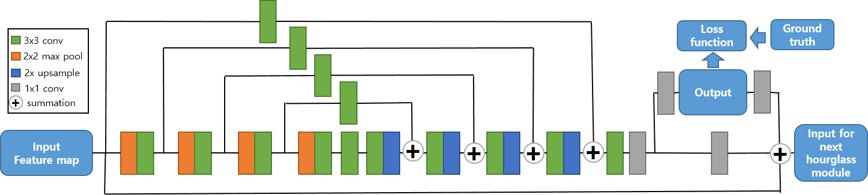
Architecture
Hourglass Module
4 Downsampling and Upsampling Steps
Downsampling - Strided Convolution , 2*2 Max Pooling , Stride =2
Upsampling - Nearest Neighbour Interpolation
Convolution with Zero Padding = 1 and Stride = 1 with 3*3 kernel size.
Feature maps at the same resolution in the downsampling and the upsampling steps are connected with an additional convolutional layer (Skip Connection)
After the last upsampling layer, a 3*3 convolution and two 1*1 convolutions are performed to generate the output which is fed into the loss function

Slide 6


Training:Loss Function
The loss function is taken to be the L1 norm between the ground truth spectrogram and the estimated spectrogram.
M(i,j) is the mask generated for audio source i in hourglass module j.
X is the input spectrogram and Y_i is the ground truth for audio source i.
Here, J(i,j) is the loss for audio source i from hourglass module j.
The final loss, J : is the sum of losses for all audio sources from each hourglass module.

Slide 7
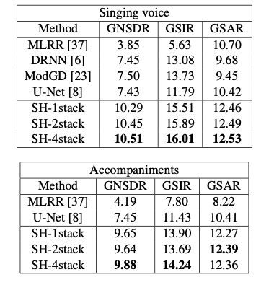
EVALUATION
We will use GNSDR, GSIR and GSAR to evaluate the performance of our model as proposed in the paper. Our aim is to achieve these results:
Source:
Sungheon Park, Taehoon Kim, Kyogu Lee, Nojun
Kwak. Licensed under a Creative Commons Attribution 4.0 International
License (CC BY 4.0). Attribution: Sungheon Park, Taehoon
Kim, Kyogu Lee, Nojun Kwak. “Music Source Separation Using Stacked
Hourglass Networks”, 19th International Society for Music Information
Retrieval Conference, Paris, France, 2018.

